Slide 1
Cc merged

Slide 2
Cloud Computing

Slide 3
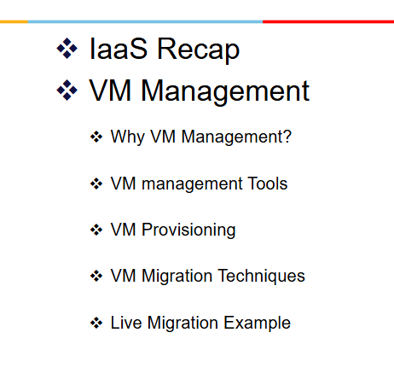
UNIT 4,5

Slide 4
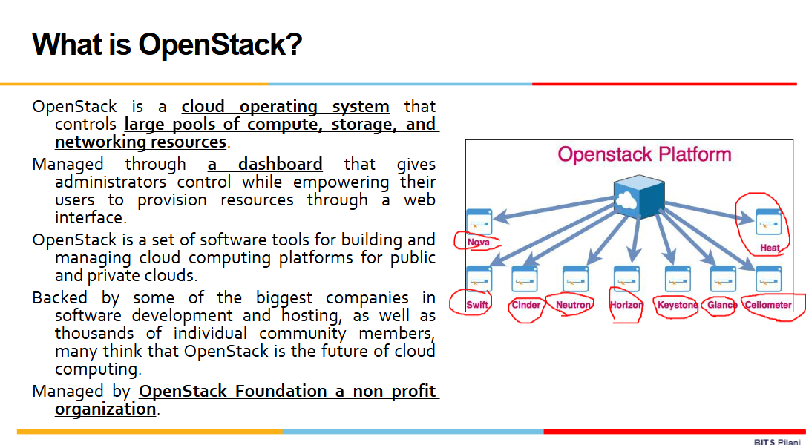
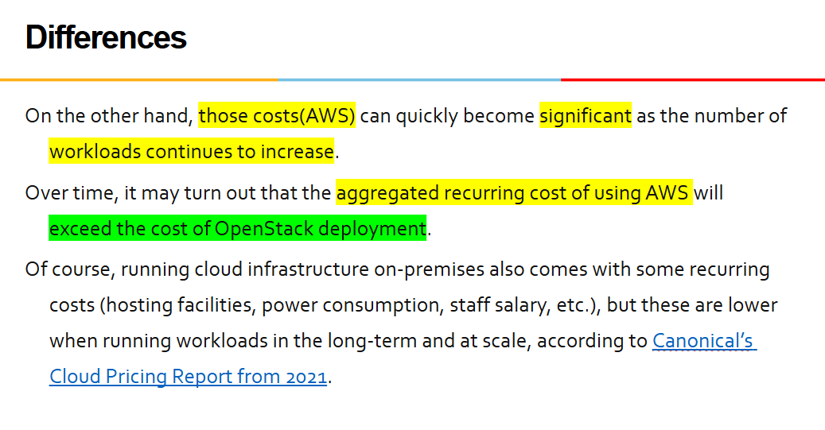
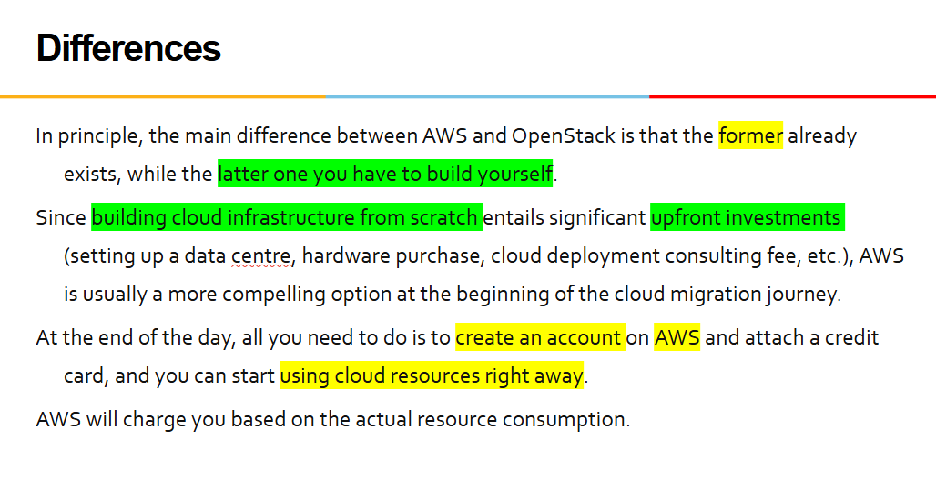

Slide 5
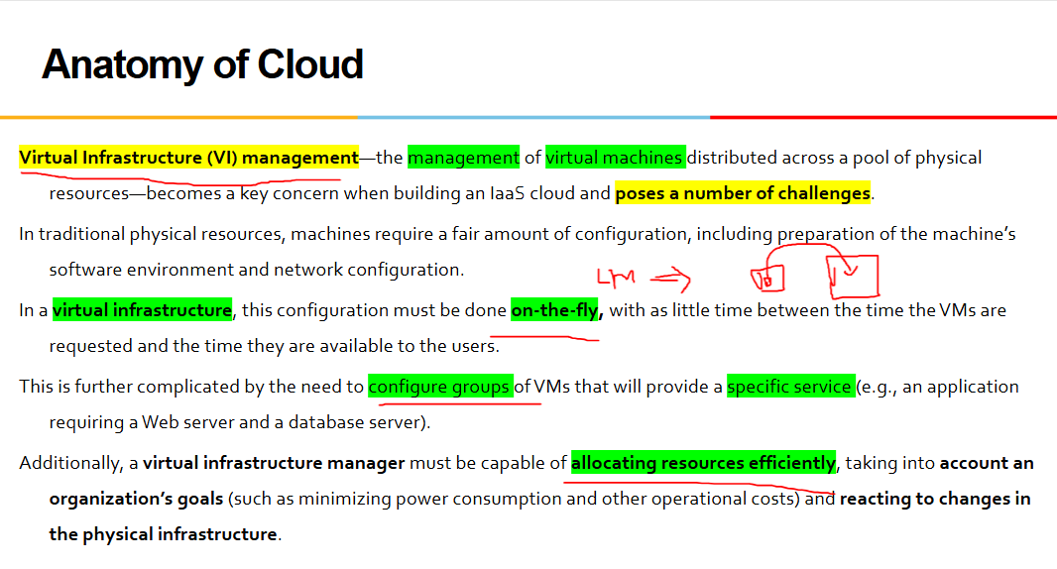
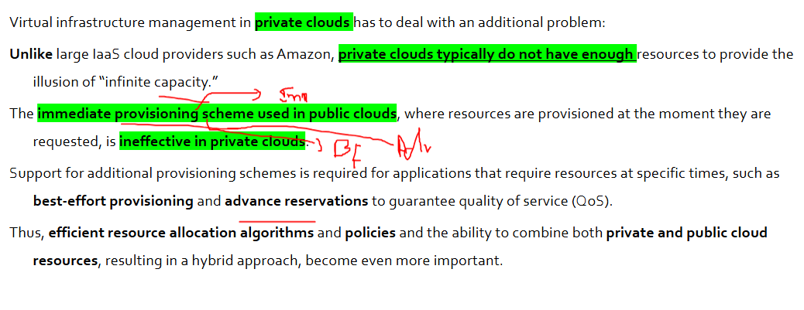

Slide 6
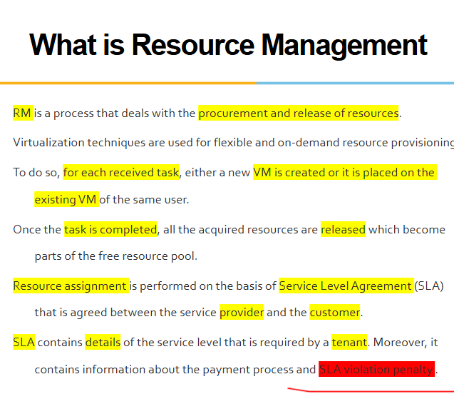
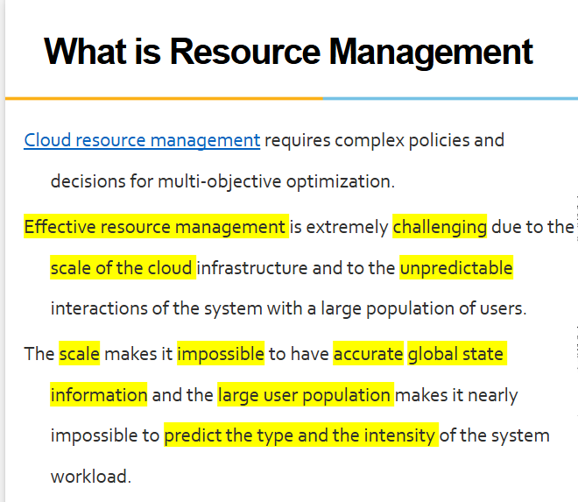

Slide 7
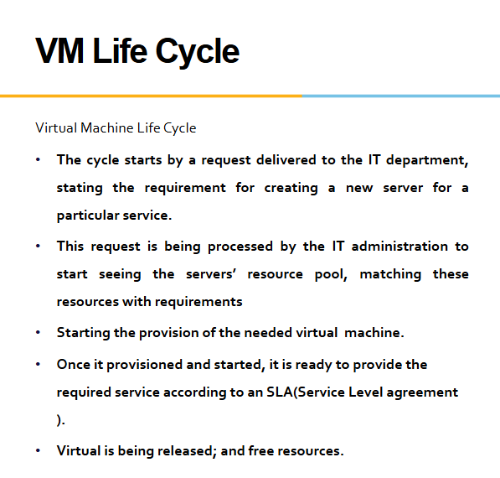
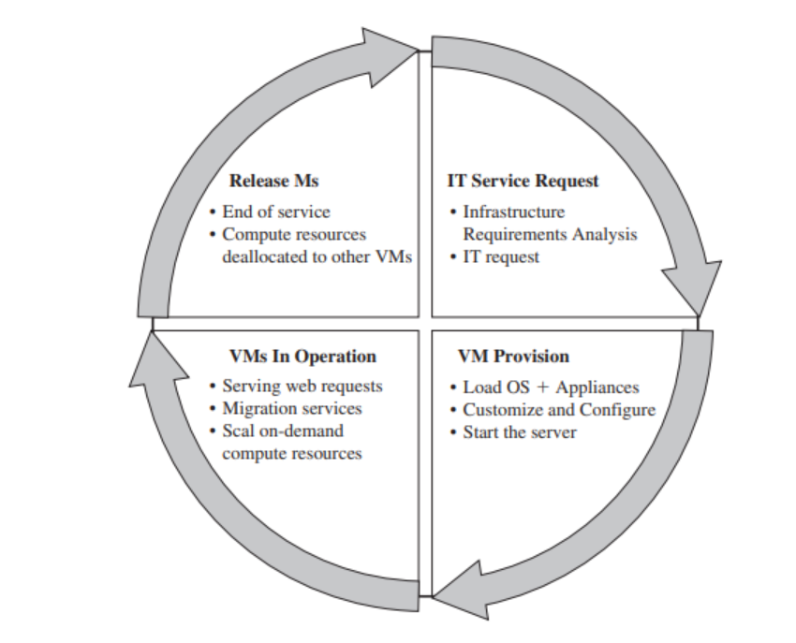

Slide 8
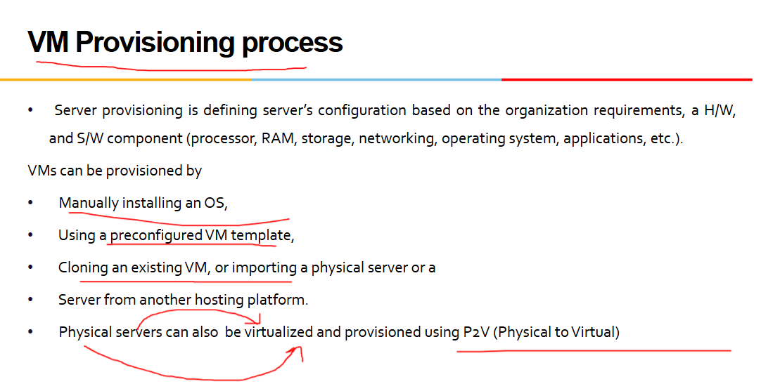
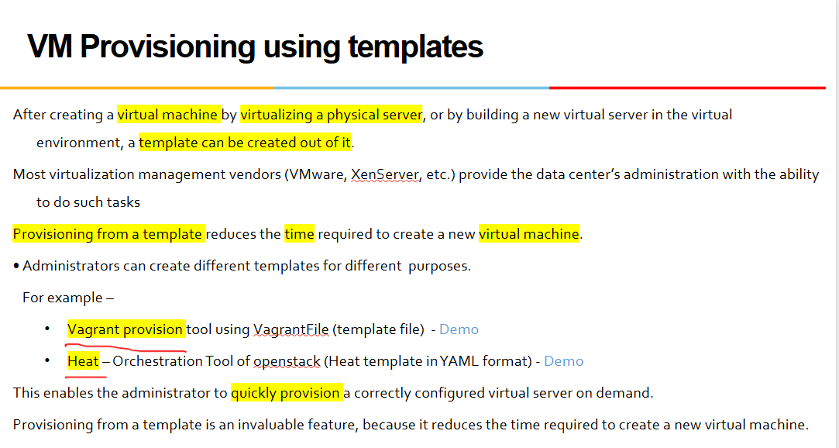
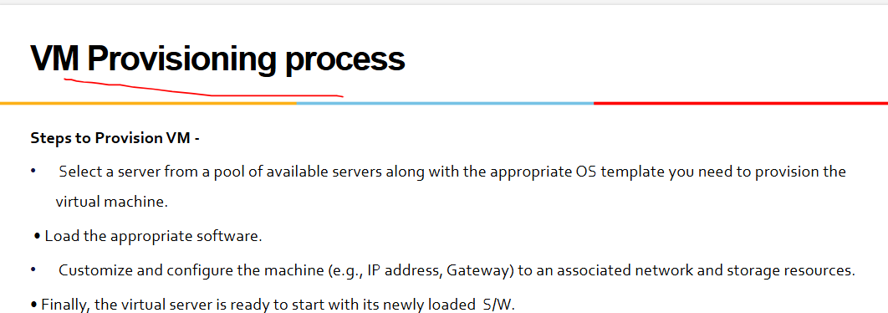
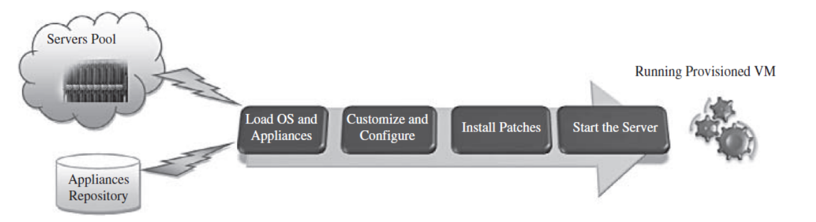

Slide 9
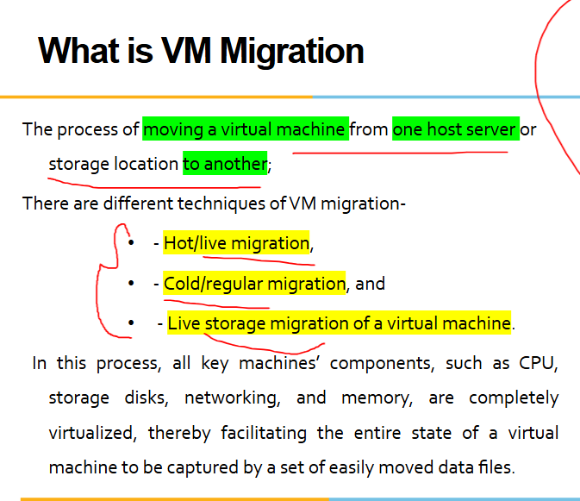
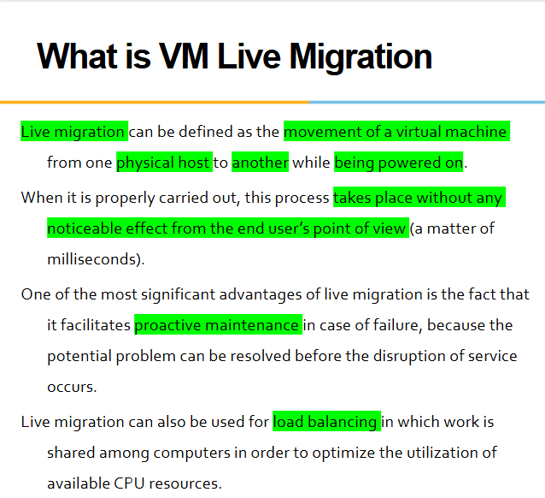
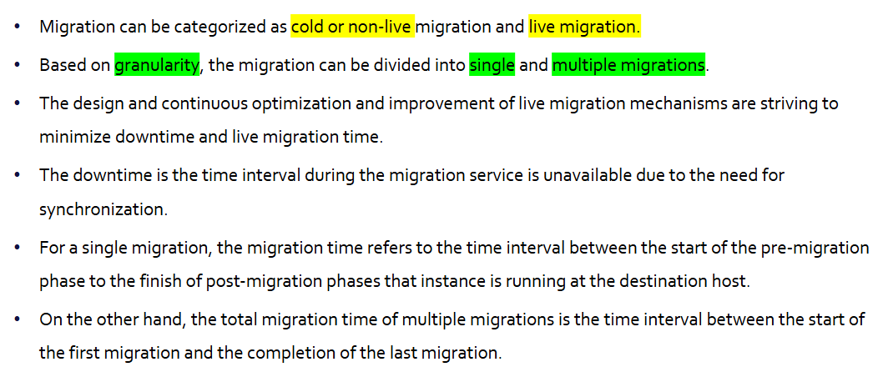
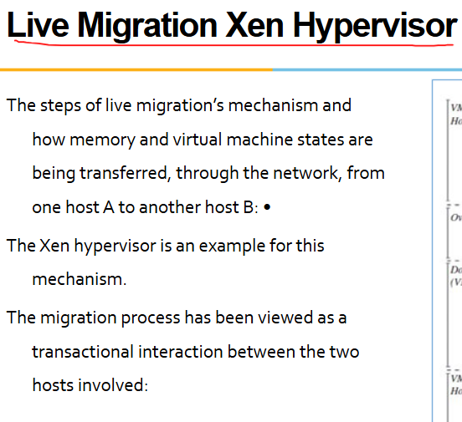

Slide 10
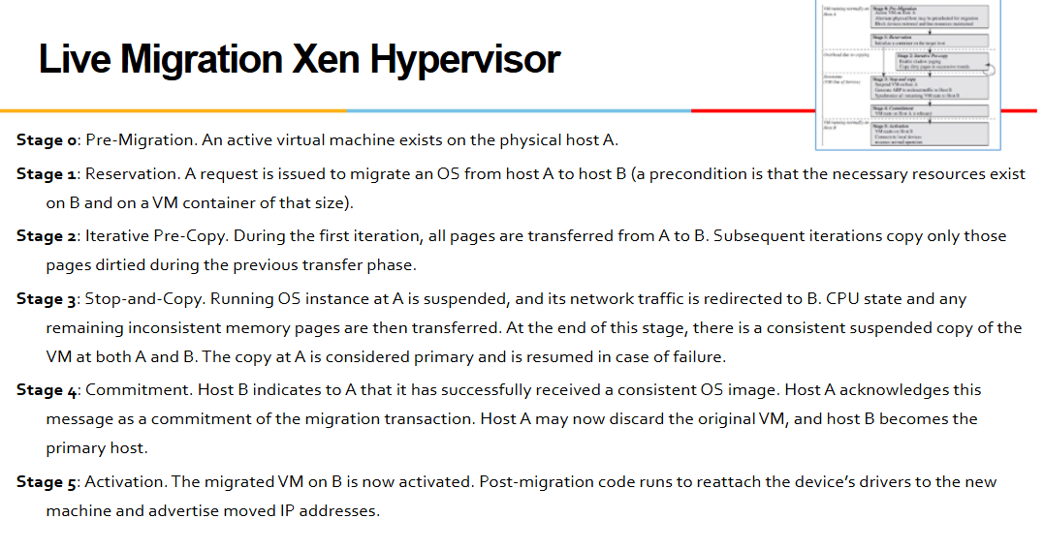
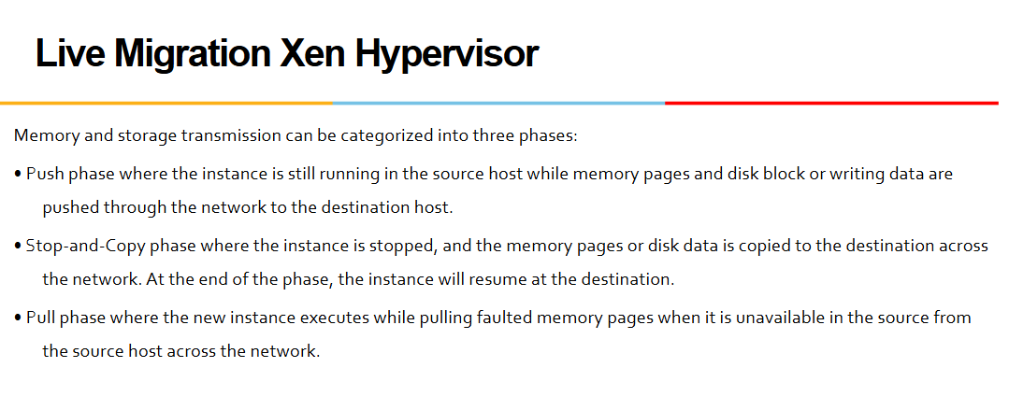
FOR Safety- not there in portion

Slide 11
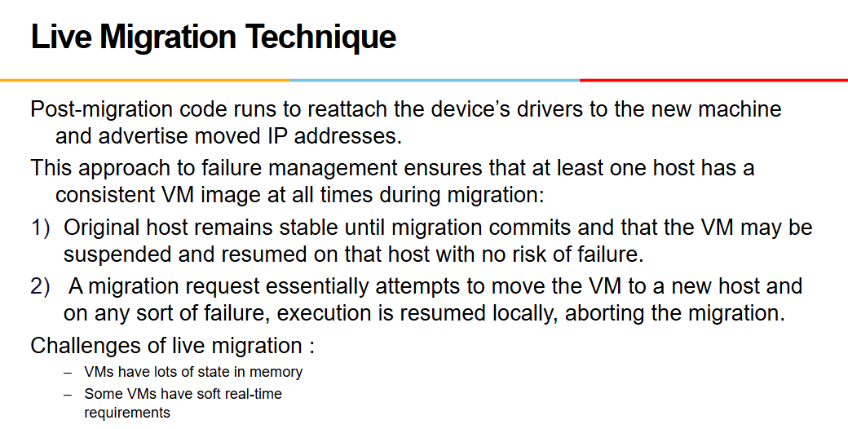
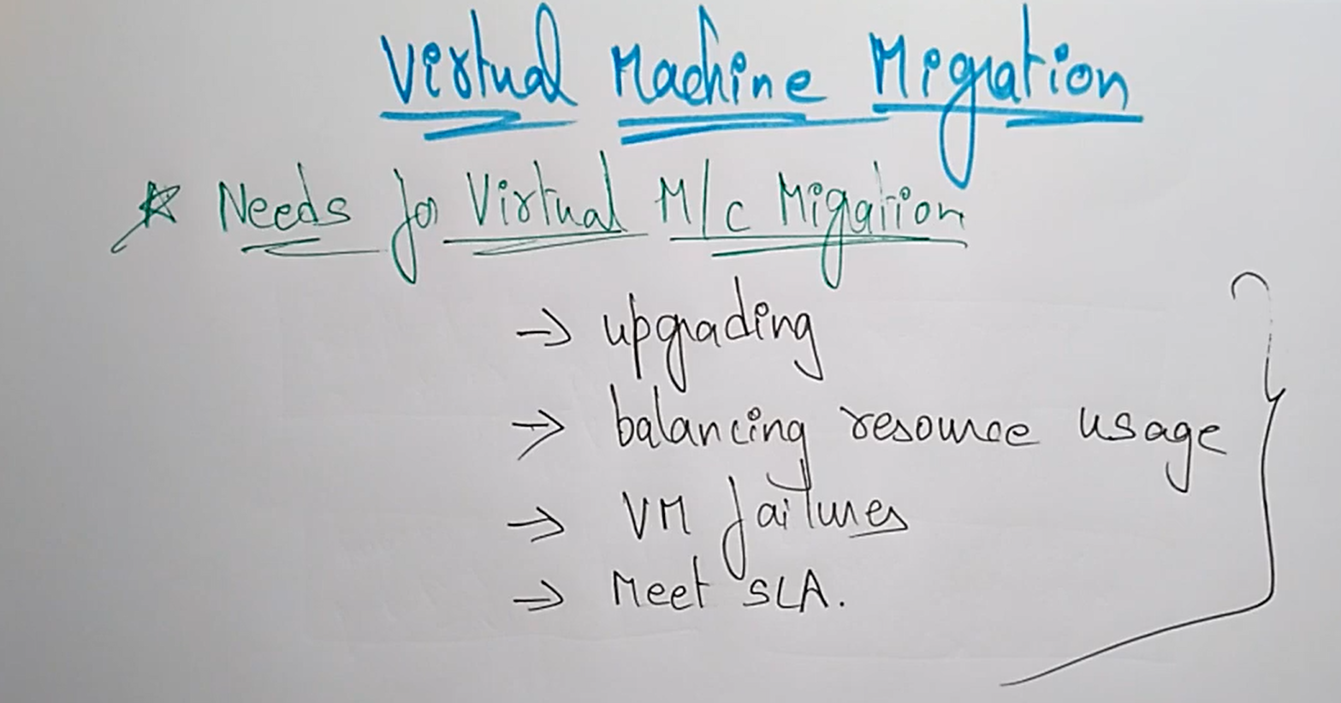
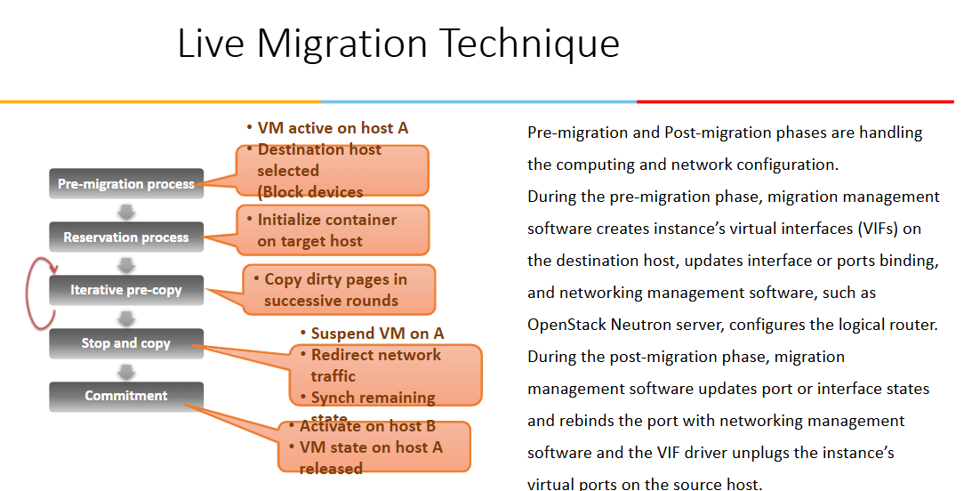
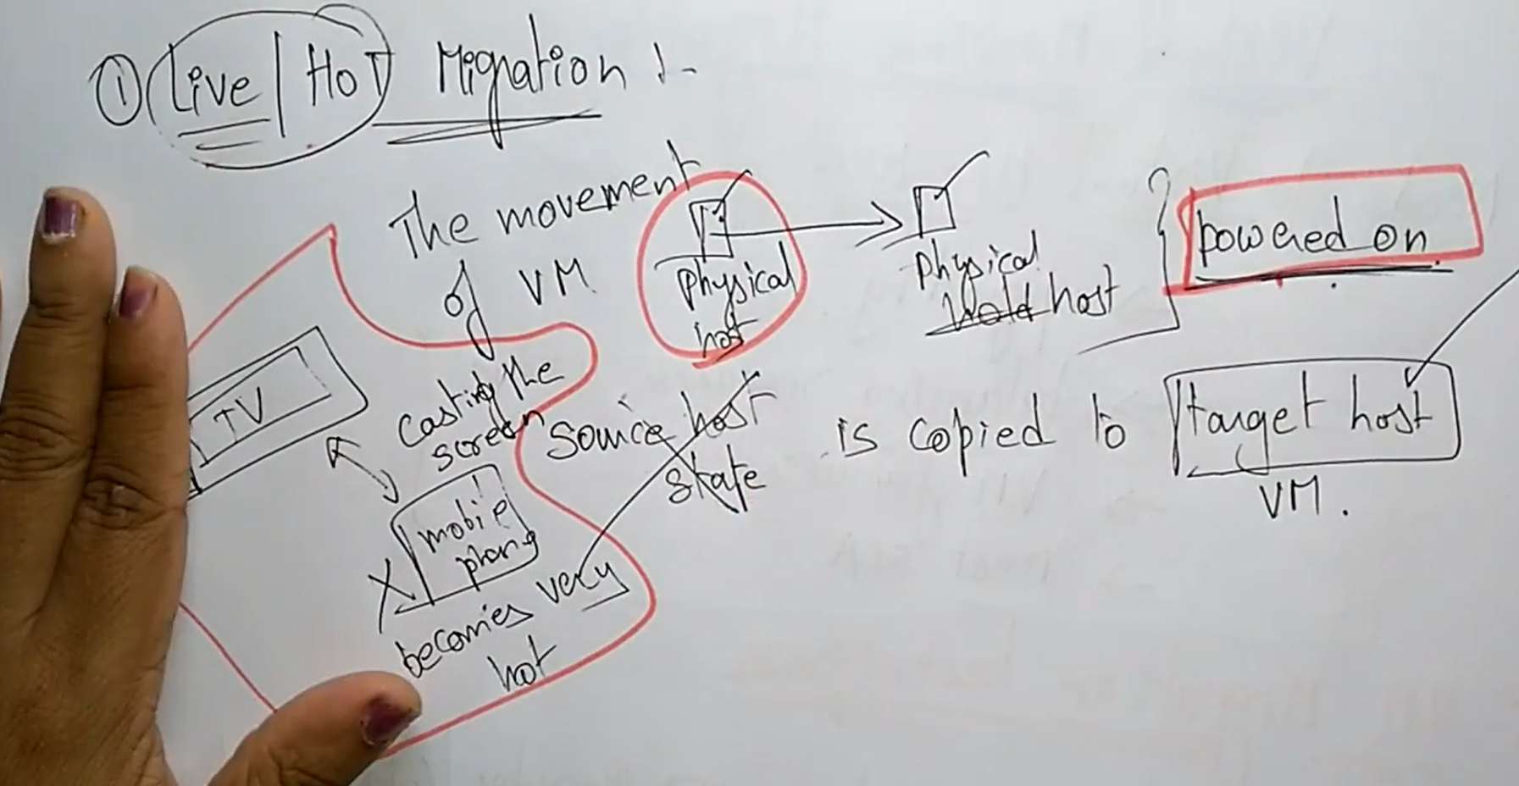

Slide 12
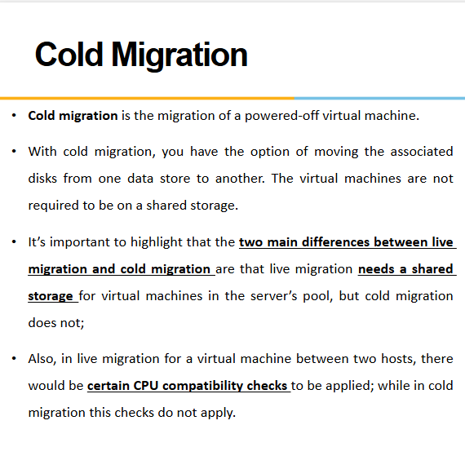
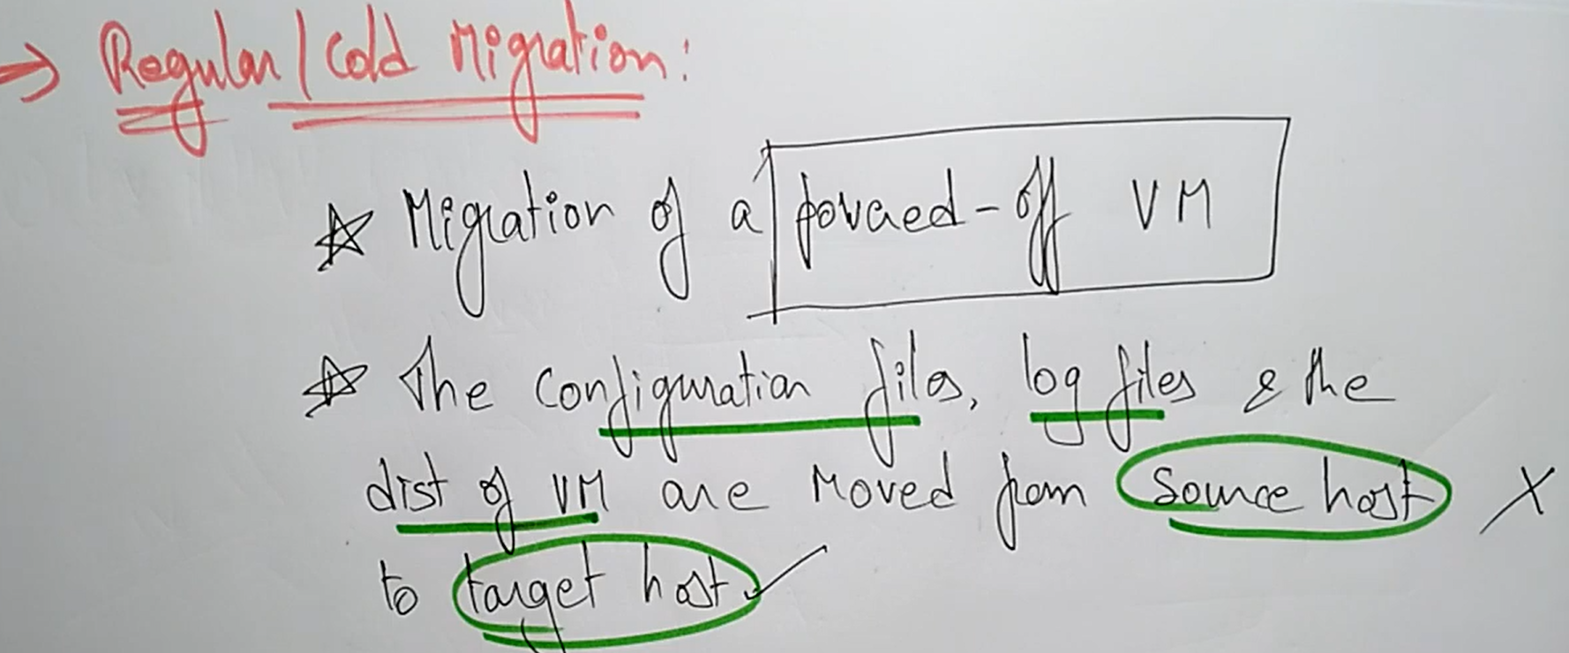
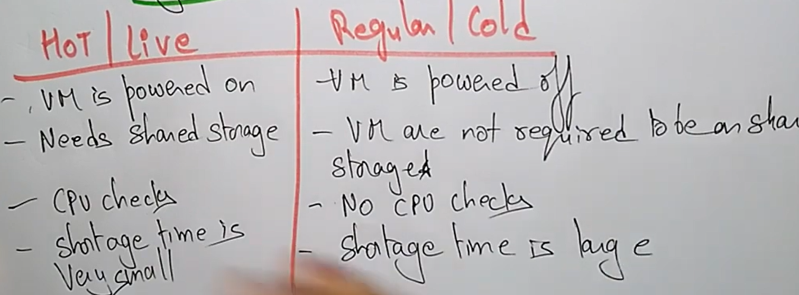

Slide 13
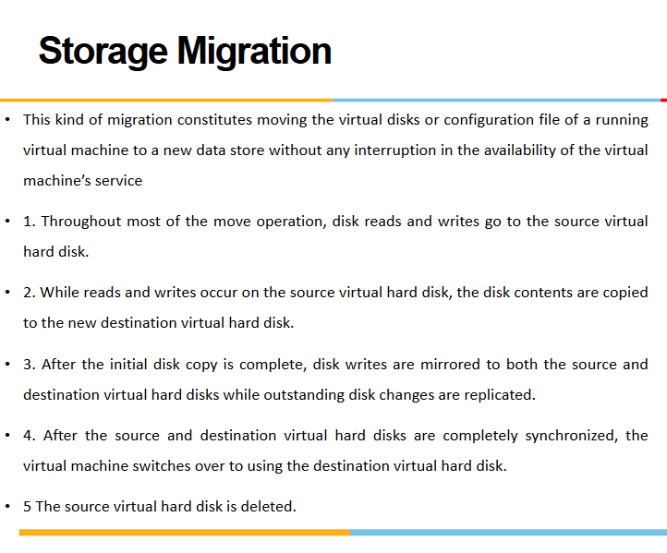

Slide 14
CLOUD COMPUTING

Slide 15
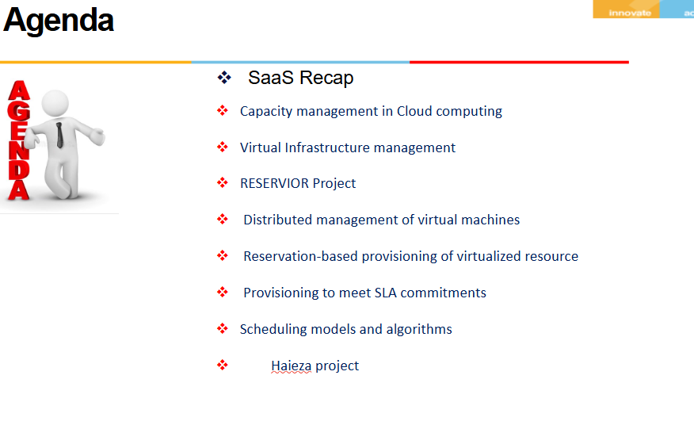
UNIT 6

Slide 16
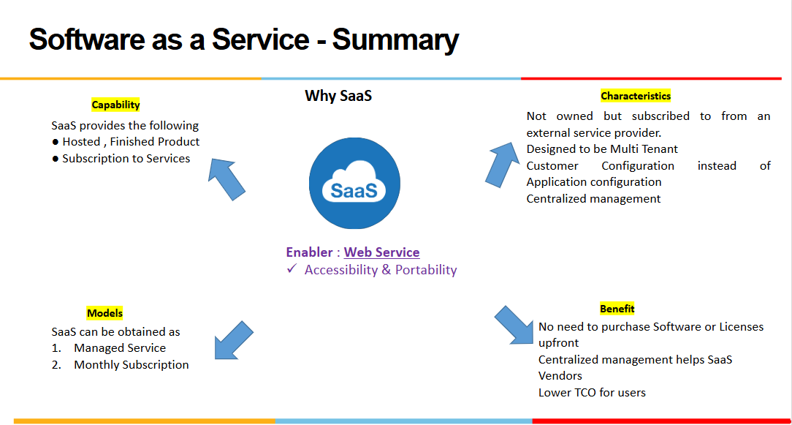
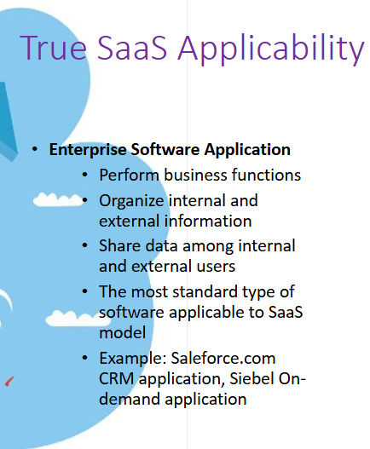

Slide 17
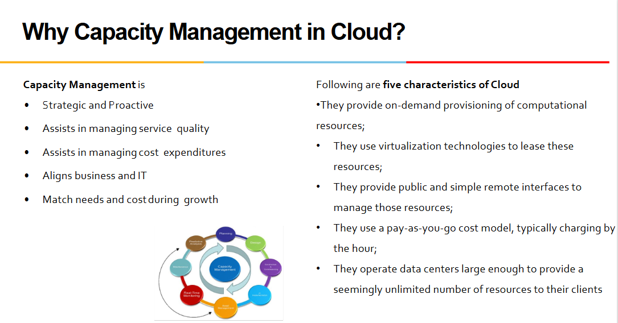
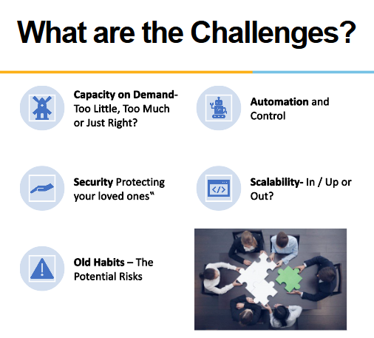
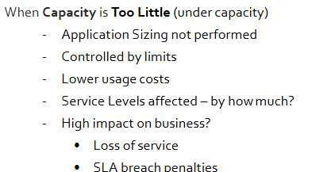
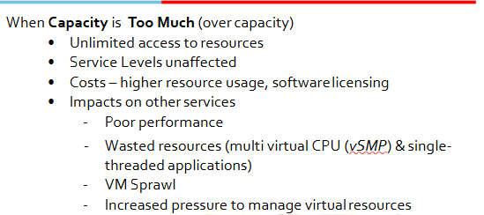

Slide 18
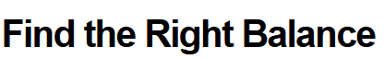
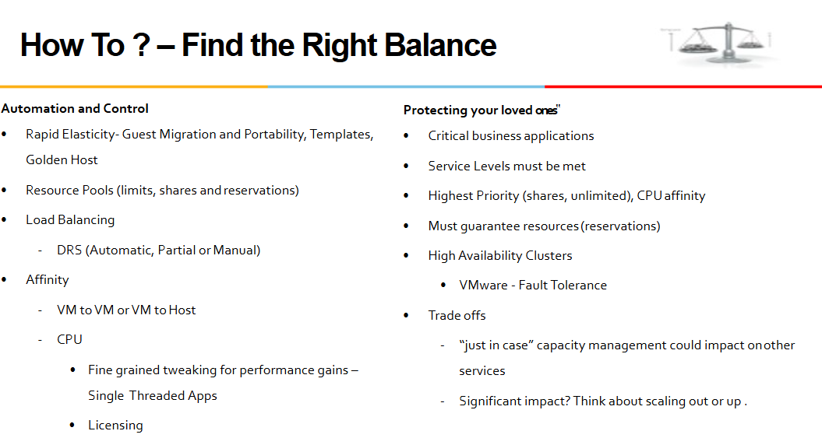
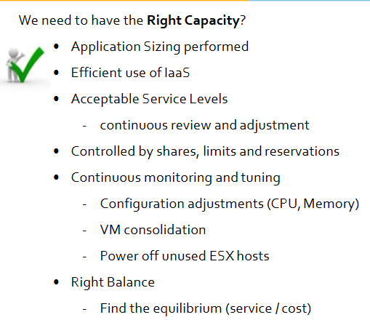
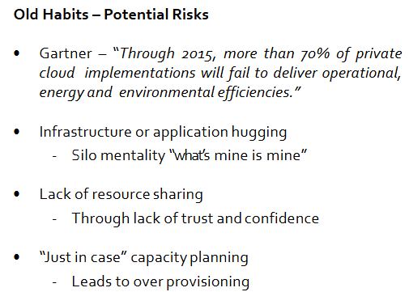

Slide 19
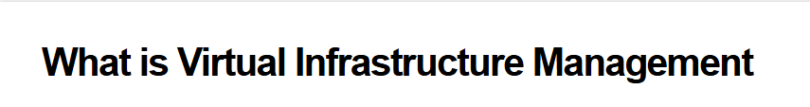
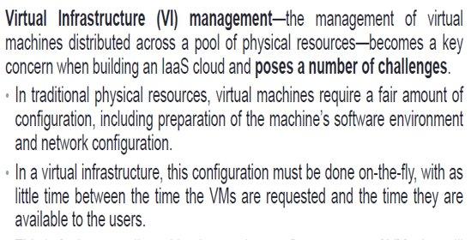
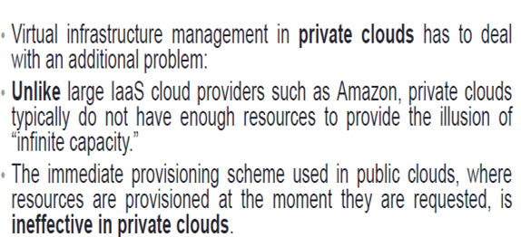
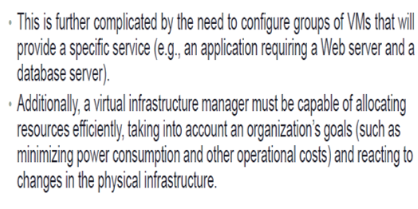

Slide 20
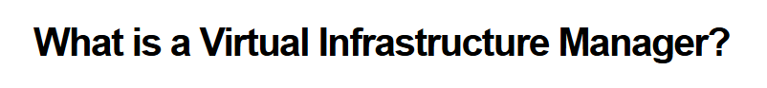
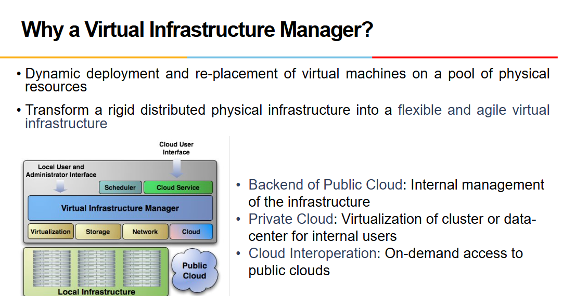
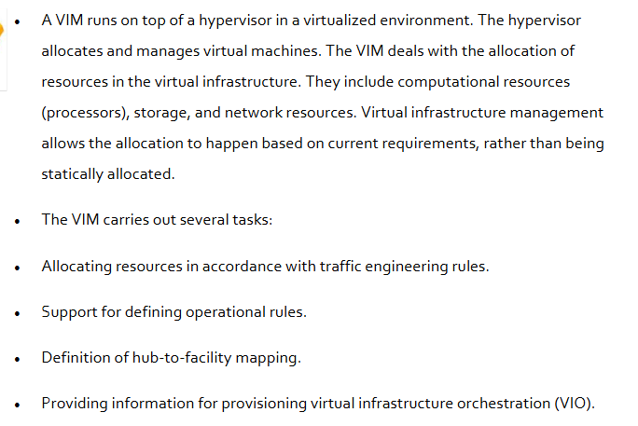
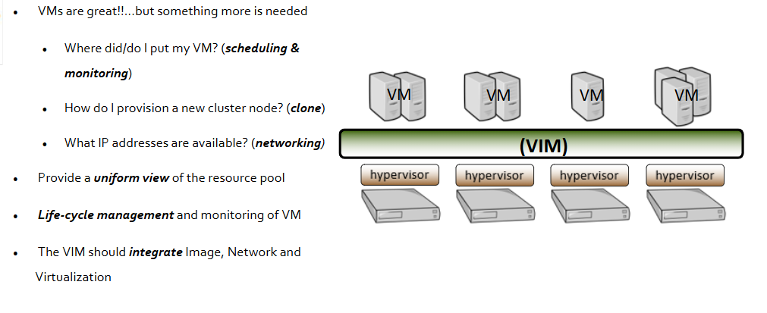

Slide 21
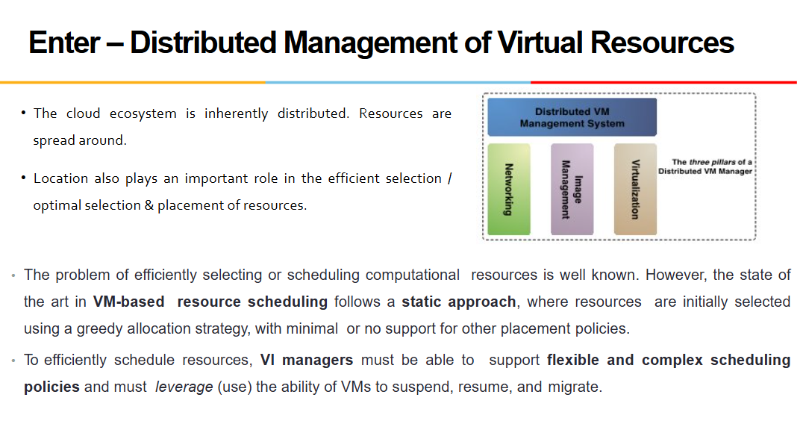
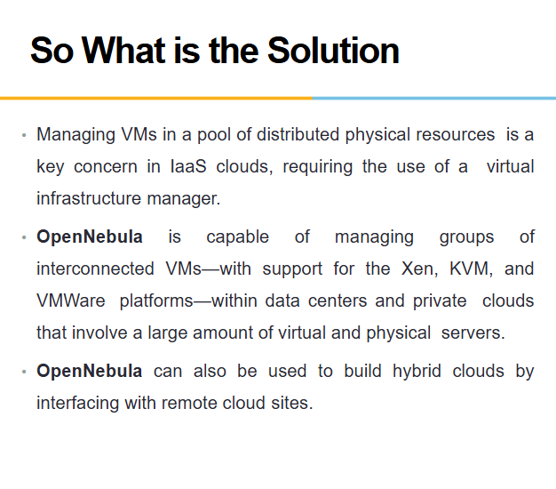

Slide 22
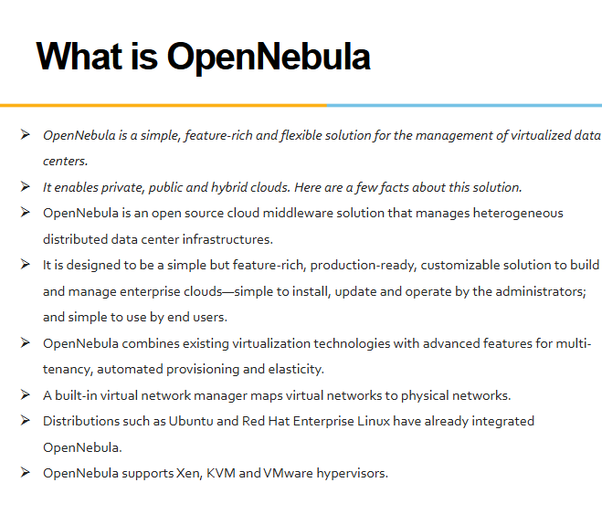


Slide 23



Slide 24





Slide 25



Slide 26





Slide 27






Slide 28



Slide 29




Slide 30



Slide 31



Slide 32



Slide 33


Slide 34


Slide 35



Slide 36

CAPACITY MANAGEMENT TO MEET SLA COMMITMENTS

Slide 37

CAPACITY MANAGEMENT TO MEET SLA COMMITMENTS
- Infrastructure SLA’s

Slide 38


Slide 39


Slide 40


Slide 41
CLOUD COMPUTING

Slide 42

Unit 7
Cloud security issues

Slide 43



Slide 44

In the multi tenant architecture, the application is redesigned to handle the resource sharing between the multiple tenants.
For example, SalesForce.com (service provider) hosts the CRM application using their infrastructure.
A company who wants to use this hosted CRM application for their business is the customer and the employees of the companies to whom the company provides privileges to access the CRM application are the actual users of the application

Slide 45
IAAS – MT Model
In (IaaS), a single physical or virtual infrastructure is shared among multiple tenants. Each tenant is provided with its own logical environment, which includes compute resources such as virtual machines (VMs), storage, networking, and other infrastructure components. There are several ways to implement a multi-tenant deployment model for IaaS:
Virtual machine isolation: In this model, each tenant is provided with a set of virtual machines that are completely isolated from other tenants. This approach provides strong security and isolation, but can be less efficient than other approaches.
Network isolation: In this model, each tenant is provided with its own virtual network that is isolated from other tenants. This approach provides better performance and efficiency than virtual machine isolation, but may require more complex network management.
Resource pool isolation: In this model, each tenant is provided with a dedicated set of compute resources such as CPU, memory, and storage that are isolated from other tenants. This approach provides good performance and resource allocation, but may be less secure than other approaches.
Hybrid model: In this model, a combination of the above models is used to meet the specific requirements of each tenant. For example, some tenants may require strong security and isolation, while others may prioritize performance and efficiency.

Slide 46
PAAS – MT Model
Application-level isolation: In this model, each tenant's application is isolated from other tenants' applications at the application level. This can be achieved through containerization or virtualization, and may also involve isolating the application's data and configuration settings.
Tenant-level isolation: In this model, each tenant is provided with a dedicated instance of the platform, which is isolated from other tenants. This approach provides strong security and isolation, but can be less efficient than other approaches.
Resource pool isolation: In this model, each tenant is provided with a dedicated set of compute resources such as CPU, memory, and storage that are isolated from other tenants. This approach provides good performance and resource allocation, but may be less secure than other approaches.
Hybrid model: In this model, a combination of the above models is used to meet the specific requirements of each tenant. For example, some tenants may require strong security and isolation, while others may prioritize performance and efficiency.

Slide 47
SAAS – MT Model
There are several ways to implement a multi-tenant deployment model for SaaS:
Database-level isolation: In this model, each tenant's data is stored in a separate database schema, which provides complete isolation and security. This approach can be efficient and scalable, but may require complex database management.
Application-level isolation: In this model, each tenant's data is kept separate at the application level, which may involve partitioning data and configuration settings. This approach can be more flexible and easier to manage than the database-level isolation model, but may be less secure.
Hybrid model: In this model, a combination of the above models is used to meet the specific requirements of each tenant. For example, some tenants may require complete data isolation, while others may be willing to share some components of the application.

Slide 48



Slide 49


Slide 50




Slide 51



Slide 52

Two major resources that need to be shared are storage and servers.
The basic principles for sharing of these resources are described first.
This is followed by a deeper discussion that focuses on the question of how these resources can be shared at a fine granularity, while allowing the tenants to customize the data to their requirements.
Sharing storage resources:
In a multi-tenant system, many tenants share the same storage system. Cloud applications may use two kinds of storage systems: File systems and databases, where the term database is used to mean not only relational databases, but NoSQL databases as well.
The discussion is focused on sharing data for different users in a database. The focus is also on multi-tenant efficient approaches where there is only one instance of the database which is shared among all the tenants

Slide 53


Slide 54
Support for Customization
Customization:
It is important for the cloud infrastructure to support customization of the stored data, since it is likely that different tenants may want to store different data in their tables.
For example, an automobile repair shop, different shops may want to store different details about the repairs carried out.
Three methods for doing this are described in the next slides. It is to be noted that difficulties for customization occur only in the shared table method.
In the dedicated table method, each tenant has their own table, and therefore can have different schema.
Pre Allocated Columns:
In shared table approach, it’s very complex to provide support for the customizations.
Each tenant might have his unique requirements to store data in the tables and using shared table approach, managing such requirements needs to come up with proper data architecture.

Slide 55

Pre allocated columns
Fixed number of columns is reserved for custom columns
If the numbers of custom column are too less than the reserved custom columns then space are wasted
If the numbers of custom columns are more than the reserved custom columns then customer will feel restricted.
XML method :
The last column of database table is reserved for storing the information in XML format
Let’s consider Tenants have following table structure that needs to be mapped to the Name-Value pair table structure.
Each tenant table has:
standard common fields and
few custom fields having varying data type

Slide 56

Multi Tenancy: Resource Sharing

Slide 57
Cloud Security Issues
Loss of Control in the Cloud
Lack of Trust in the Cloud
Consumer’s loss of control
Data, applications, resources are located with provider
User identity management is handled by the cloud
User access control rules, security policies and enforcement are managed by the cloud provider
Consumer relies on provider to ensure
Data security and privacy
Resource availability
Monitoring and repairing of services/resources
Trusting a third party requires taking risks
Defining trust and risk
Opposite sides of the same coin (J. Camp)
People only trust when it pays (Economist’s view)
Need for trust arises only in risky situations
Defunct third party management schemes
Hard to balance trust and risk
e.g. Key Escrow (Clipper chip)
Is the cloud headed toward the same path?

Slide 58


Slide 59
Taxonomy of Fear - CIA
Confidentiality
Fear of loss of control over data
Will the sensitive data stored on a cloud remain confidential?
Will cloud compromises leak confidential client data
Will the cloud provider itself be honest and won’t peek into the data?
Integrity
How do I know that the cloud provider is doing the computations correctly?
How do I ensure that the cloud provider really stored my data without tampering with it?
Availability
Will critical systems go down at the client, if the provider is attacked in a Denial of Service attack?
What happens if cloud provider goes out of business?
Would cloud scale well-enough?
Often-voiced concern
Although cloud providers argue their downtime compares well with cloud user’s own data centers

Slide 60
Threat Model
A threat model helps in analyzing a security problem, design mitigation strategies, and evaluate solutions
Steps:
Identify attackers, assets, threats and other components
Rank the threats
Choose mitigation strategies
Build solutions based on the strategies
Basic components
Attacker modeling
Choose what attacker to consider
insider vs. outsider?
single vs. collaborator?
Attacker motivation and capabilities
Attacker goals
Vulnerabilities / threats

Slide 61
Data Security and Storage
Several aspects of data security, including:
Data-in-transit
Confidentiality + integrity using secured protocol
Confidentiality with non-secured protocol and encryption
Data-at-rest
Generally, not encrypted , since data is commingled with other users’ data
Encryption if it is not associated with applications?
But how about indexing and searching?
Processing of data, including multitenancy
For any application to process data

Slide 62


Part III. Possible Solutions
Cloud consumer needs situational awareness for critical applications
When underlying components fail, what is the effect of the failure to the mission logic
What recovery measures can be taken
by provider and consumer

Slide 63



Slide 64


Slide 65
What is SLA or Service Level Agreement
Describes a set of non functional requirements of the service.
Example : RTO time – Return to Operation Time if case of failure
SLO – Service Level Objective. That is, the objective to be achieved.
KPI – Key Performance Indicators
Service Level Objective:
Objective of service quality that has to be achieved.
Set of measurable KPIs with thresholds to decide if the objective is fulfilled or not.
Attainable
Repeatable
Measurable
Understandable
Meaningful
Controllable
Affordable
Mutually acceptable

Slide 66
SLA Role in High Availability
What is High Availability
Driven by SLA (Service Level Agreement)
High Availability must conform to SLA. Goal here is to meet promised quality
Examples: Service is available 99.95%.
Net Banking : Guarantees banking 24 x7 . There are published down times called “ SYSTEM MAINTENANCE” window
Duronto Express : Promises point to point service with only Service halts
What deters HA
Service outage which was unplanned because of Server or Human Error
Service Disruption by Planned Maintenance windows (Downtime)
Service Performance degradation due to lack of infrastructure or failure of critical components during peak load time
Bottom Line : Need effective Capacity Planning to meet promised QoS or in other words maintain HA thus adhering to the SLA’s

Slide 67
Steps for HA
Steps to achieve high availability
Build for server failure
Have redundant servers which can be made online
Build for zone failure
Having DR sites in case of failure to switch over to backup site
Build for Cloud failure
Plan for your Cloud setup to be robust and contained. Errors should not cascade, having fire door policy to contain threats or errors which affect the ecosystem
Automating and testing
Test & Test again, low manual interference

Slide 68
SLA vs SLO
The SLA is the entire agreement that specifies
what service is to be provided,
how it is supported,
times,
locations,
costs,
performance, and
responsibilities of the parties involved.
SLOs are specific measurable characteristics of the SLA such as
availability,
throughput,
frequency,
response time, or quality.
SLIs are actual measure of the SLO and serves as a benchmark to compare against the promised SLO
availability,
throughput,
frequency,
response time, or quality.

Slide 69
SLA
In the early days of web-application deployment, performance of the application at peak load was a single important criterion for provisioning server resources.
Provisioning in those days involved deciding hardware conﬁguration, determining the number of physical machines, and acquiring them upfront so that the overall business objectives could be achieved.
The web applications were hosted on these dedicated individual servers within enterprises’ own server rooms. These web applications were used to provide different kinds of e-services to various clients.
Due to the increasing complexity of managing the huge Data centres, enterprises started outsourcing the application hosting to the infrastructure providers. They would procure the hardware and make it available for application hosting.
It necessitated the enterprises to enter into a legal agreement with the infrastructure service providers to guarantee a minimum quality of service (QoS).
Typically, the QoS parameters are related to the availability of the system CPU, data storage, and network for efﬁcient execution of the application at peak loads.
This legal agreement is known as the service-level agreement (SLA)

Slide 70
Traditional SLO Management Approaches
Load balancing – is to distribute the incoming request onto a set of physical machines, each hosting a replica of an application, so that the load on the machines is equally distributed. Front end node (node facing the client) receives the incoming requests and distributes these requests to different physical machines for further execution. Back end nodes serves the incoming requests.
Class agnostic load balancing – the front end machine are agnostic to nature of request. This means that the front end machine is neither aware of the type of client from which the request originates nor aware of the request category.
Class aware load balancing – The front end node additionally inspect the type of client making the request and/or the type of service requested before deciding which back end node should service the request.
Admission Control – These algorithms plays important role in deciding the set of requests that should be admitted into the application server when the server experiences very heavy loads. The objective of admission control mechanisms is to police the incoming requests and identify when the system faces overload situations.

Slide 71
Request based algorithms – reject new requests if the servers are running to their capacity. The disadvantage is that client’s session may consist of multiple requests that are not necessarily unrelated. Some requests are rejected even if there are others that are honored.
Session based algorithms – ensure that longer sessions are completed and any new sessions are rejected. Once a session is admitted into the server, all future requests belonging to that session are admitted as well, even though new sessions are rejected by system.

Slide 72
SLA Types
Infrastructure SLA – Infrastructure provider manages and offers guarantees on availability of the infrastructure, namely server machine, power, network connectivity and so on. Enterprises manage their applications that are deployed on these server machines. The machines are leased to customers and are isolated from machines of other customers.
For example, SLAs can be
Hardware availability – 99% uptime in a calendar month
Power availability – 99.99% of the time in calendar month
Data center network availability – 99.99% of the time in calendar month
Application SLA – In application co-hosting model, the server capacity is available to the applications based solely on their resource demands. Hence the service providers are flexible in allocating and de-allocating computing resources among the co-located applications. Therefore the service providers are also responsible for ensuring to meet their customers application SLOs.
For example, SLAs can be
Web site response time (max of 3.5 sec per user request), Latency of web server (max of 0.2 sec per request), Latency of DB (max of 0.5 sec per query)

Slide 73



Slide 74



Slide 75


SLA LC Management – Cloud Applications

Slide 76
Feasibility Analysis
Managed Service Providers(MSP) conducts the feasibility study of hosting an application on their cloud platforms.
This study involves three kinds of feasibility:
(a) Technical feasibility,
(b) Infrastructure feasibility
(c) Financial feasibility.
The technical feasibility of an application implies determining the following:
1. Ability of an application to scale out.
2. Compatibility of the application with the cloud platform being used within the MSP’s data center.
3. The need and availability of a specific hardware and software required for hosting and running of the application.
4. Preliminary information about the application performance and whether they can be met by the MSP.

Slide 77



Slide 78



Slide 79



Slide 80


Slide 81
CLOUD COMPUTING
UNIT 8

Slide 82


Slide 83



Slide 84


The first layer is the foundation and contains the database servers.
A database cluster will have at least two servers to replicate data and a backup routine to retrieve data.
Most BaaS providers use NoSQL databases on their technology stacks due to scaling flexibility, but there is a growing trend to use SQL databases like Postgres.
The second layer is the application cluster and contains multiple servers to process requests. The quantity of servers fluctuates throughout the time of the day, and auto-scaling procedures are necessary to fulfill the group with the correct amount of servers.
The third layer connects the application servers to the Internet, and it’s composed of load balancers and CDNs.

Slide 85
BaaS vs IaaS
Imagine you would like to build a new software project and that you will not use a BaaS. The first step before you start developing the backend side code is to set up the servers. Here is how it will work:
Login on AWS or any other cloud.
Go to Instances
Launch Instance
Select the Operating System
Instance Size, Type
Configure Instance Details
Number of instances ,Network, IP, Monitoring, Other settings like Auto Scaling, IAM, etc
Add Storage
Security Settings
All right, your instance is up and running, and now you can start coding! Not really! That is only the first step of the process, and you will still need to install the web-server, database, framework, etc.
After all that is done, you can start coding. The time to perform this process can range from a few hours (for a small project with skilled backend developers) to more than a day for large environments.
This same process using a backend as a service will be done with a few clicks and take no more than a few minutes.

Slide 86



Slide 87


Slide 88


Slide 89


Slide 90


Slide 91
Serverless Disadvantages
1. Not suitable for long term tasks: Serverless are a good option for short term or real time tasks. If a task takes longer time to complete then the company might end up paying more for compute time. For example, if a large file has to be uploaded that takes more time then it will require additional functions till it’s complete and the developer ends up paying more for that.
2. High non-performance penalty: A business pays for what they use, but if they end up not using these functions then there will be a high non-performance penalty. These functions may suffer from cold start penalty as well and can be very slow when used after a certain period of time.
3. Vendors lock in: When a business depends on a vendor for all its backend services for a web application, it ends up losing control over their hardware, updates and run times. If they want to switch then it gets very difficult. A business or developer has to re-engineer if they wish to switch to another service provider.
4. Security concerns: New security concerns are introduced when a vendor provides servers to a business. This can be a huge problem if the application contains personal or sensitive information like credit card details. This happens because companies are not given their own physical servers, vendors will be running code for many customers on a single server.

Slide 92



The approach of building an application out of a set of modular components is known as microservice architecture.
Dividing an application into microservices is appealing to developers because it means they can create and modify small pieces of code which can be easily implemented into their codebases.
This is in contrast to monolithic architecture, in which all the code is interwoven into one large system.
With large monolithic systems, even a minor changes to the application requires a hefty deploy process.
FaaS eliminates this deploy complexity. Using serverless code like FaaS, web developers can focus on writing application code, while the serverless provider takes care of server allocation and backend services.

Slide 93


Slide 94



Slide 95



Slide 96
EDGE Computing
Edge computing is a networking philosophy focused on bringing computing as close to the source of data as possible in order to reduce latency and bandwidth use.
In simpler terms, edge computing means running fewer processes in the cloud and moving those processes to local places, such as on a user’s computer, an IoT device, or an edge server.
Bringing computation to the network’s edge minimizes the amount of long-distance communication that has to happen between a client and server.
What is the Edge?
For Internet devices, the network edge is where the device, or the local network containing the device, communicates with the Internet. The edge is a bit of a fuzzy term; for example a user’s computer or the processor inside of an IoT camera can be considered the network edge, but the user’s router, ISP, or local edge server are also considered the edge. The important takeaway is that the edge of the network is geographically close to the device, unlike origin servers and cloud servers, which can be very far from the devices they communicate with.

Slide 97

EDGE Computing Use Cases

Slide 98


Slide 99


Slide 100


Slide 101



Slide 102




Slide 103


AZURE SREVICES

Slide 104


AZURE SERVICES

Slide 105



Slide 106



Slide 107




Slide 108



